Slide 1
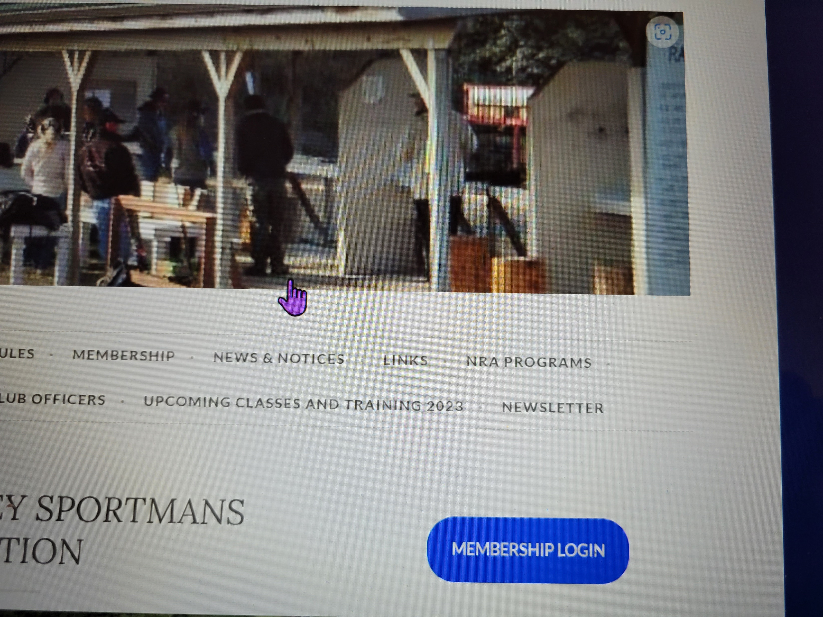
Click on membership login

Slide 2
Log into your account

Slide 3
Click on Past Year then select last 30 days

Slide 4
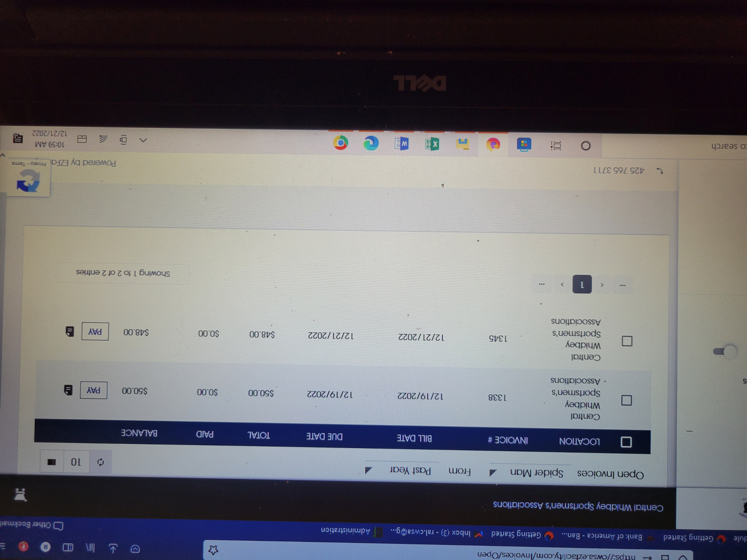
See your Invoices

Slide 5
Click Pay to pay invoices

Slide 6
Check out

Slide 7
Input your credit card information and click on complete checkout and your done

